Slide 1
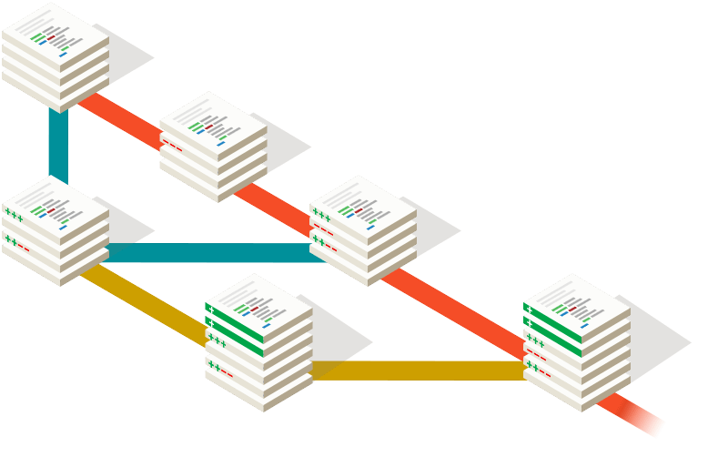
Common Problems in Developing Software Projects
Burak Özcan
A. Şemsettin Özdemirden
Utku Savaş

Slide 2


Slide 3
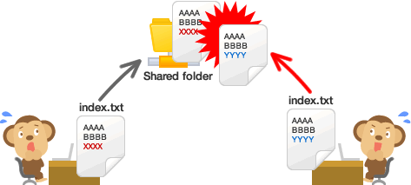
Trying to Change Same File

Slide 4
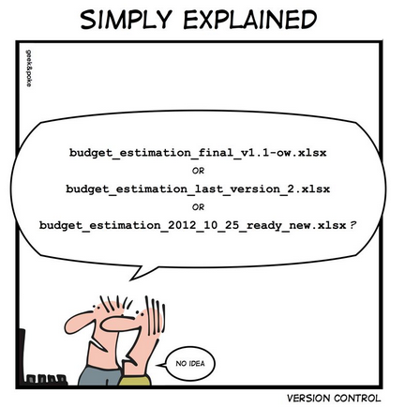
Naming Files

Slide 5
WHAT IS VCS? IS IT A DESERT?

Slide 6

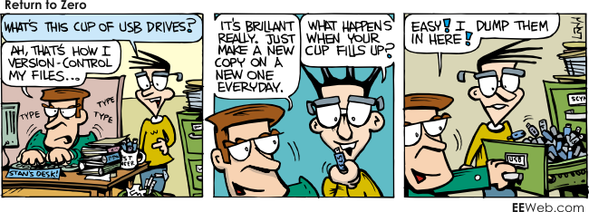

Slide 7
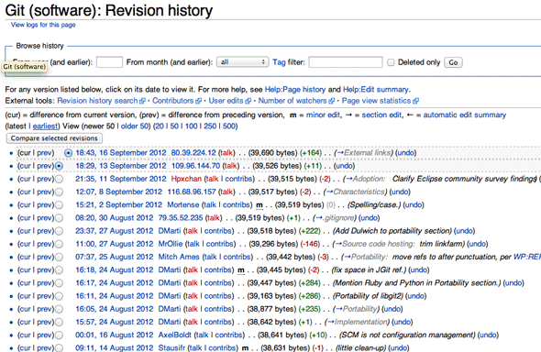

Slide 8

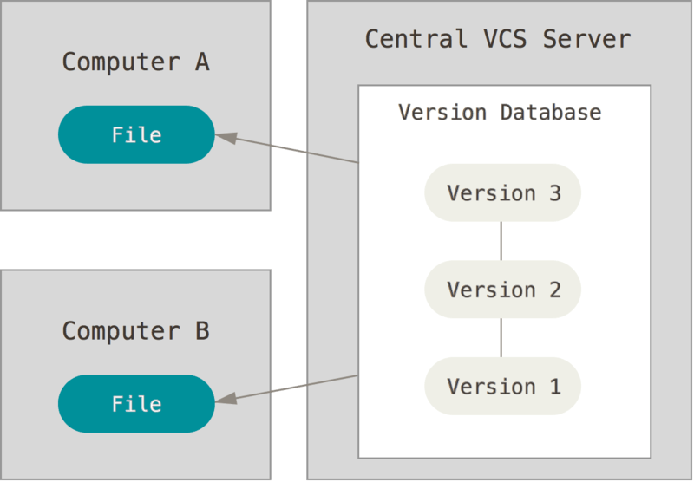
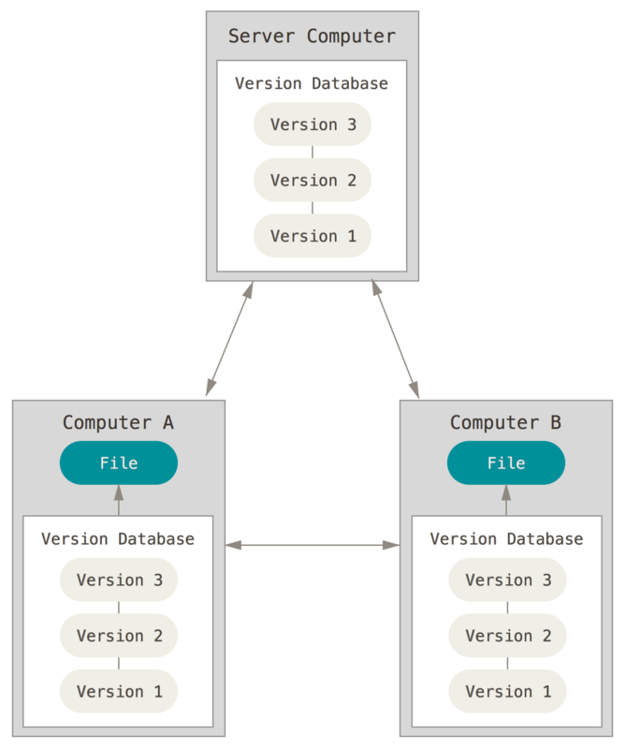
Main Types of VCS
Local VCS
Centralized VCS
Distributed VCS

Slide 10

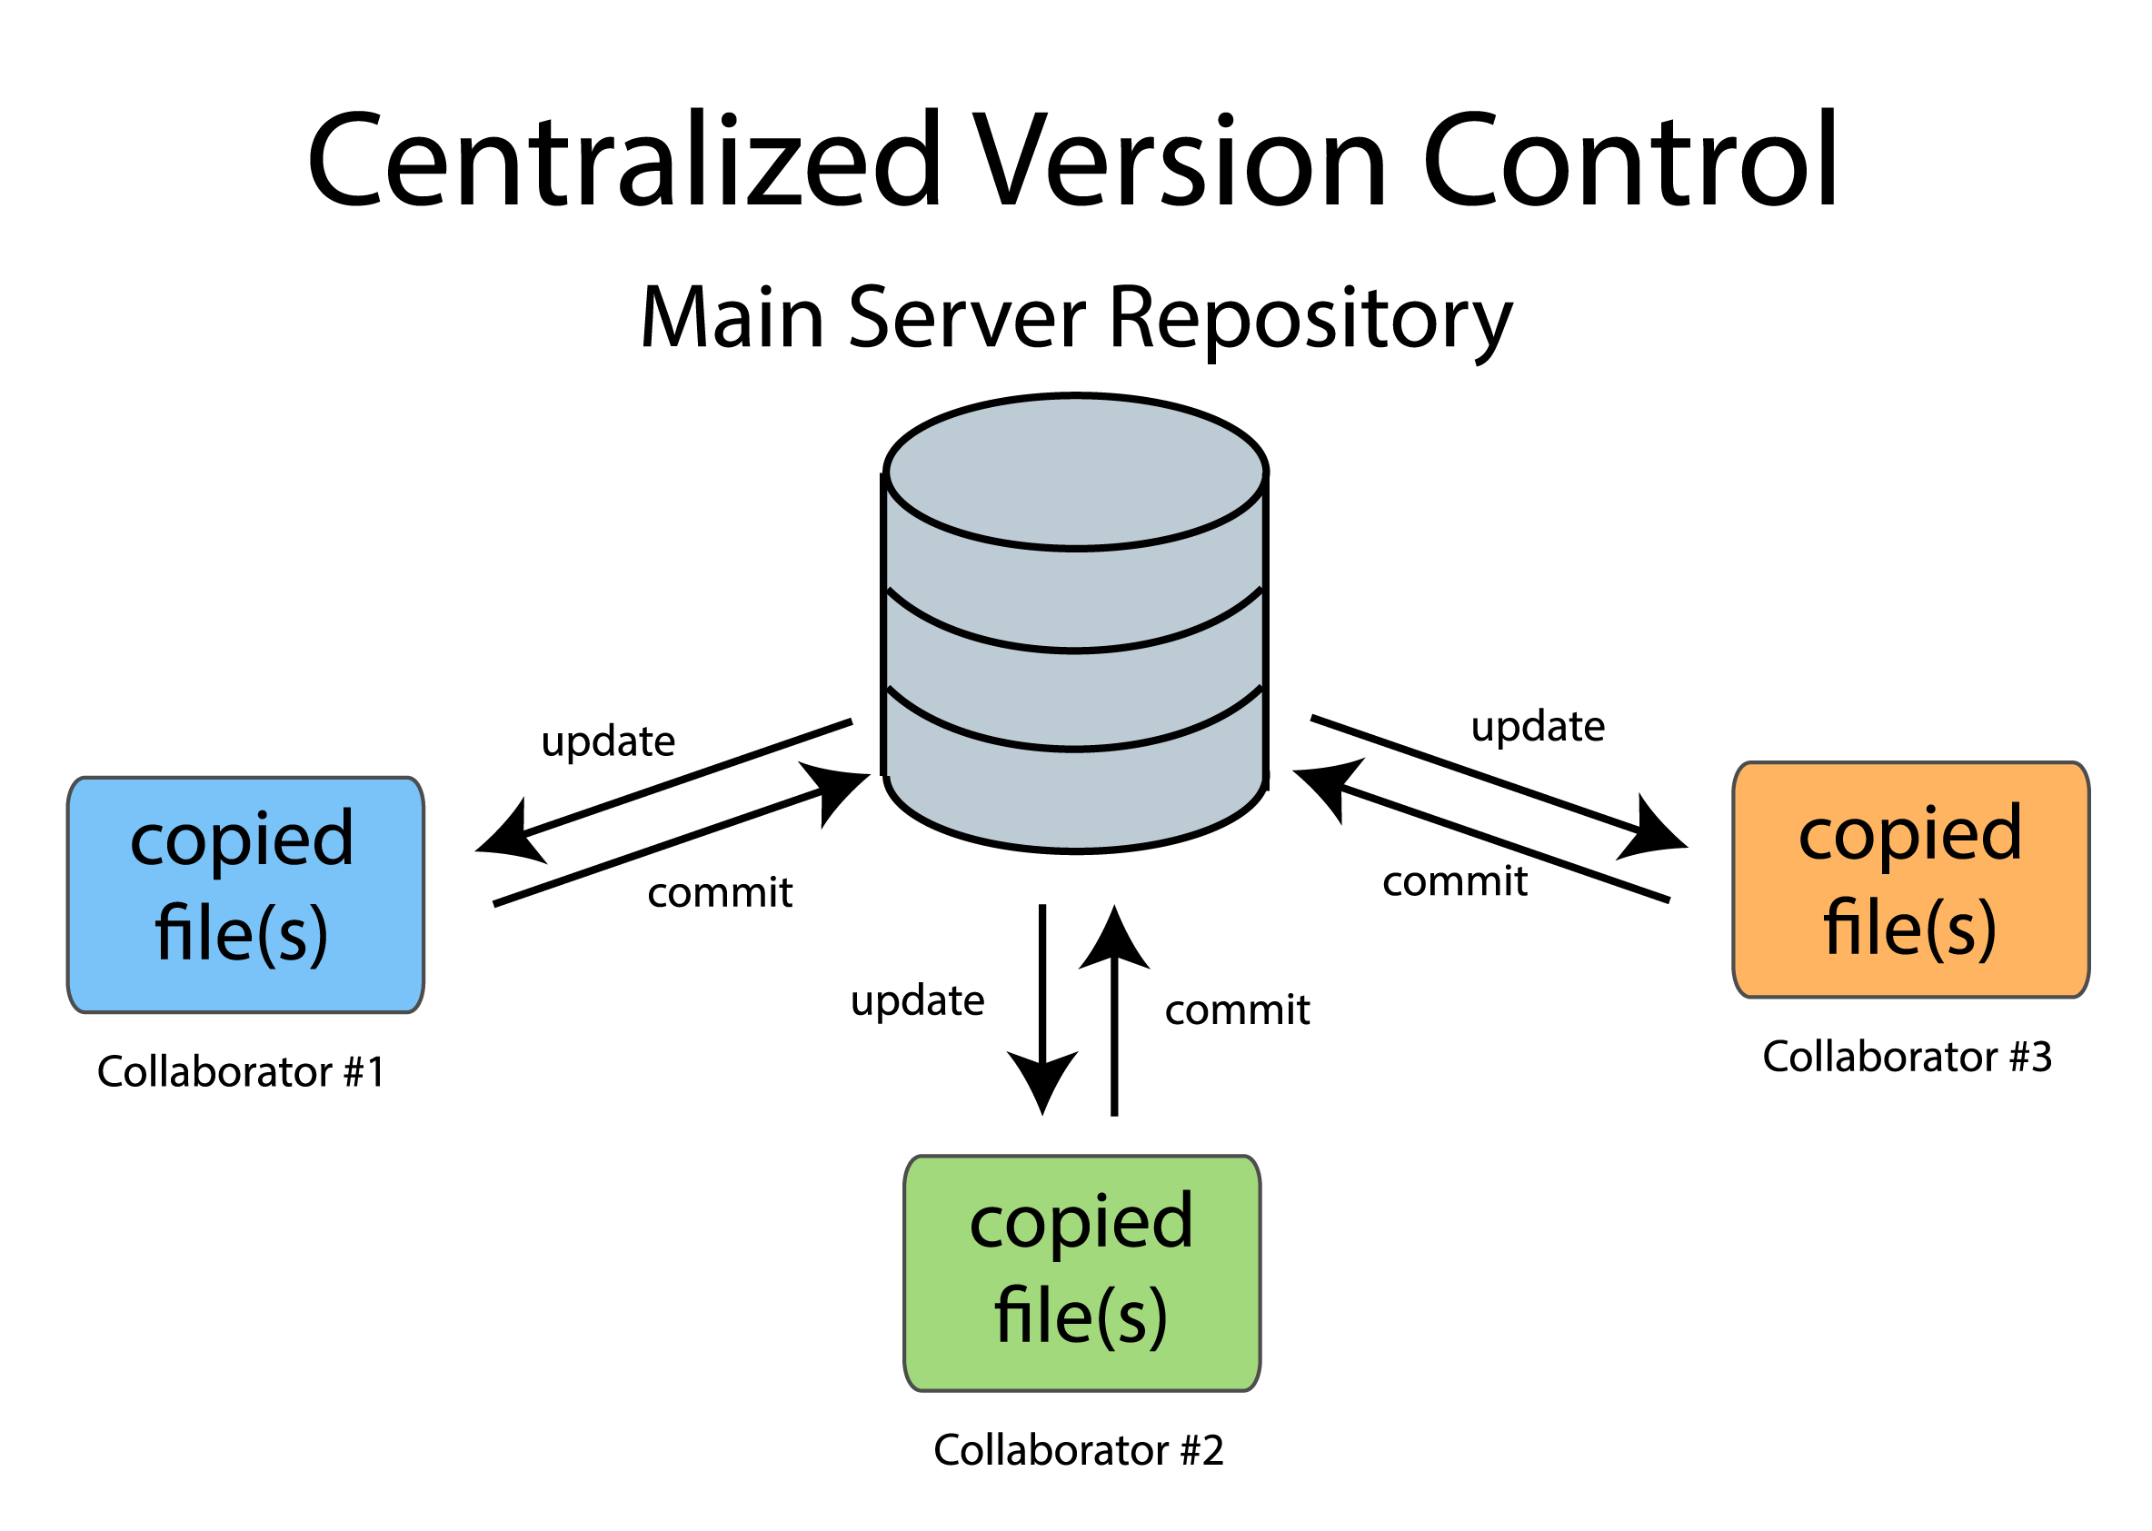

Slide 11
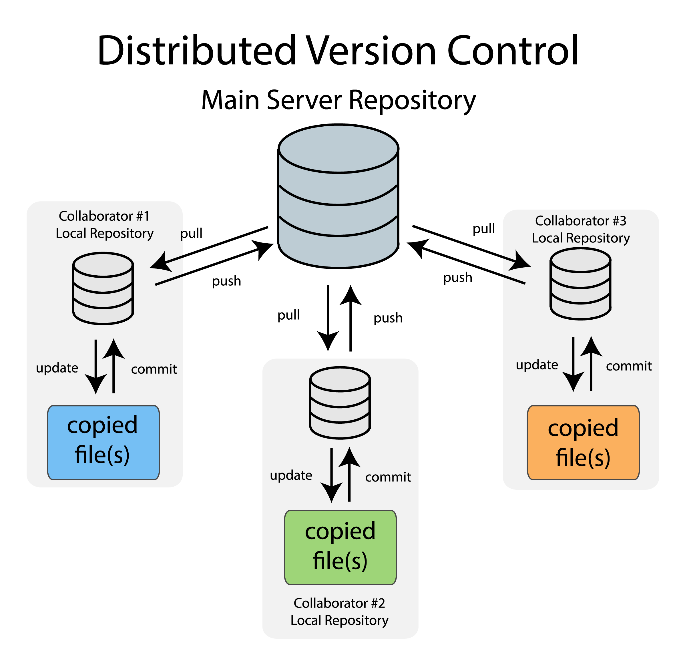

Slide 12
THANK YOU!

Slide 13
SOURCES
QUESTIONS?
http://mikemcquaid.com/2014/01/18/why-use-version-control/
http://www.makeuseof.com/tag/git-version-control-youre-developer/
http://soundsoftware.ac.uk/why-version-control

